Slide 1
ECE 551 Digital Design And Synthesis
Spring ‘19
Simulator Mechanics
Testbench Basics (stimulus generation)
Dataflow Verilog

Slide 2
Administrative Matters
HW2 Posted and due in 2 weeks. Weds Feb 20th
Purchase of DE0 Nano boards (1 per every 2 people)
We are setting up an online store
Can rent for $35 or buy for $70
If you rent you must return in good shape to receive a grade
Watch Videos on rest of Lecture03 materials
Monday will be a quiz on Lecture03 materials.

Slide 3
Analog Simulation (Spice Engine)
Divide “time” into slices
Update information in whole circuit at each slice
Used by SPICE
Allows detailed modeling of current and voltage
Computationally intensive and slow
Don’t need this level of detail for most digital logic simulation

Slide 4
Digital Simulation
Could update every signal on an input change
0
1
0
1
0
1
1
0
0
1
1
1
0
1
1
0
1
1
1
1
0
0
Could update just the full path on input change
0
1
0
1
0
1
1
0
0
1
1
1
0
1
1
0
1
1
1
1
0
0
Don’t even need to do that much work!

Slide 5
Event-Driven Simulation
When an input to the simulating circuit changes, put it on a “changed” list
Loop while the “changed” list isn’t empty:
Remove a signal from the “changed” list
For each sink of the signal
Recompute its new output(s)
For any output(s) that have changed value, add that signal to the “changed” list
When the “changed” list is empty:
Keep simulation results
Advance simulation time to next stimulus (input) event

Slide 6
Simulation
Update only if changed
Some circuits are very large
Updating every signal => very slow simulation
Event-driven simulation is much faster!
0
1
0
1
0
1
1
0
0
1
1
1
0
1
1
0
1
1
1
1
0
0

Slide 7
Testbench Basics (stimulus generation)
Need to verify your design
“Design Under Test” (DUT)
Use a “testbench”
Verilog module with no ports
Generates or routes inputs to the DUT
For now we will monitor outputs via human interface
Inputs
DUT
Outputs
Stimulus
Inputs
DUT
Outputs
OR
(Response)
(Response)
Testbench
Testbench

Slide 8
Simulation Example
4
a[3:0]
adder4bit
(DUT)
4
sum[3:0]
Our DUT is a simple
4-bit adder, with carry
in and carry out
4
b[3:0]
c_out
c_in
Use a consistent
naming convention for your test benches:
I usually add _tb to the end of the unit name
4
a[3:0]
adder4bit
(DUT)
4
4
sum[3:0]
b[3:0]
c_out
c_in
adder4bit_tb

Slide 9
Simulation Example
`timescale 1ns /100 fs // time_unit/time_precision
module adder4bit_tb;
reg[8:0] stim; // inputs to DUT are regs
wire[3:0] S; // outputs of DUT are wires
wire C4;
// instantiate DUT
adder4bit(.sum(S), .c_out(C4), .a(stim[8:5]), .b(stim[4:1]), .c(stim[0]));
// stimulus generation
initial begin
stim = 9'b0000_0000_0; // at 0 ns
#10 stim = 9'b1111_0000_1; // at 10 ns
#10 stim = 9'b0000_1111_1; // at 20 ns
#10 stim = 9'b1111_0001_0; // at 30 ns
#10 stim = 9'b0001_1111_0; // at 40 ns
#10 $stop; // at 50 ns – stops simulation
end
endmodule

Slide 10
Testbench Requirements
Instantiate the unit being tested (DUT)
Provide input to that unit
Usually a number of different input combinations!
Watch the “results” (outputs of DUT)
Can watch ModelSim Wave window…
Can print out information to the screen or to a file
This way of monitoring outputs (human interface) is dangerous & incomplete.
Subject to human error
Cannot be automated into batch jobs (regression suite)
Self checking testbenches will be covered later

Slide 11
Output Test Info
Several different system calls to output info
$monitor
Output the given values whenever one changes
Can use when simulating Structural, RTL, and/or Behavioral
$display, $strobe
Output specific information like a printf in a C program
Used in Behavioral Verilog
Can use formatting strings with these commands
Only means anything in simulation
Ignored by synthesizer

Slide 12
Output Format Strings
Formatting string
%h, %H hex
%d, %D decimal
%o, %O octal
%b, %B binary
%t time
$monitor(“%t: %b %h %h %h %b\n”, $time, c_out, sum, a, b, c_in);
Can get more details from Verilog standard

Slide 13
Output Example
module adder4bit_tb;
reg[8:0] stim; // inputs to DUT are regs
wire[3:0] S; // outputs of DUT are wires
wire C4;
// instantiate DUT
adder4bit(.sum(S), .c_out(C4), .a(stim[8:5]), .b(stim[4:1]), .c(stim[0]));
initial $monitor(“%t A:%h B:%h ci:%b Sum:%h co:%b\n”,$time,
stim[8:5],stim[4:1],stim[0],C4,S);
// stimulus generation
initial begin
stim = 9'b0000_0000_0; // at 0 ns
#10 stim = 9'b1111_0000_1; // at 10 ns
#10 stim = 9'b0000_1111_1; // at 20 ns
#10 stim = 9'b1111_0001_0; // at 30 ns
#10 stim = 9'b0001_1111_0; // at 40 ns
#10 $stop; // at 50 ns – stops simulation
end
endmodule

Slide 14
Generating Clocks
Wrong way: initial begin #5 clk = 0; #5 clk = 1; #5 clk = 0; … (repeat hundreds of times) end
Right way:
LESS TYPING
Easier to read, harder to make mistake
initial clk = 0;
always
#5 clk = ~clk;
initial begin
clk = 0;
forever #5 clk = ~clk;
end
14

Slide 15
Exhaustive Testing
For combinational designs w/ up to 8 or 9 inputs
Test ALL combinations of inputs to verify output
Could enumerate all test vectors, but don’t…
Generate them using a “for” loop!
reg [4:0] x; initial begin
for (x = 0; x < 16; x = x + 1) #5; // need a delay here! end
Need to use “reg” type for loop variable? Why?

Slide 16
Why Loop Vector Has Extra Bit
Want to test all vectors 0000 to 1111 reg [3:0] x; initial begin
for (x = 0; x < 16; x = x + 1) #5; // need a delay here! end
If x is 4 bits, it only gets up to 1111 => 15
1100 => 1101 => 1110 => 1111 => 0000 => 0001
x is never >= 16… so loop goes forever

Slide 17
Example: DUT
module Comp_4 (A_gt_B, A_lt_B, A_eq_B, A, B);
output A_gt_B, A_lt_B, A_eq_B;
input [3:0] A, B;
// Code to compare A to B
// and set A_gt_B, A_lt_B, A_eq_B accordingly
endmodule

Slide 18
Example: Testbench
module Comp_4_tb();
wire A_gt_B, A_lt_B, A_eq_B;
reg [4:0] A, B; // sized to prevent loop wrap around
Comp_4 M1 (A_gt_B, A_lt_B, A_eq_B, A[3:0], B[3:0]); // DUT
initial $monitor(“%t A: %h B: %h AgtB: %b AltB: %b AeqB: %b”, $time, A[3:0], B[3:0], A_gt_B, A_lt_B, A_eq_B);
initial #2000 $finish; // end simulation, quit program
initial begin
#5 for (A = 0; A < 16; A = A + 1) begin // exhaustive test of inputs
for (B = 0; B < 16; B = B + 1) begin #5; // may want to test x’s and z’s
end // first for
end // second for
end // initial
endmodule
note multiple initial blocks

Slide 19
Do ModelSim Example Here
ModelSim Example of 3-bit wide adder block
3
a[2:0]
adder3bit
(DUT)
3
3
sum[2:0]
b[2:0]
c_out
c_in

Slide 20
Stimulus for Sequential Circuits
Imagine an 8-bit counter with an active low reset signal.
When en=0 the count is frozen
The counter counts up if up_dwn_n=1 or down if up_dwn_n=0
up_dwn_n
en
8
cnt
rst_n
clk
What should the testbench look like?
How should the stimulus be generated?

Slide 21
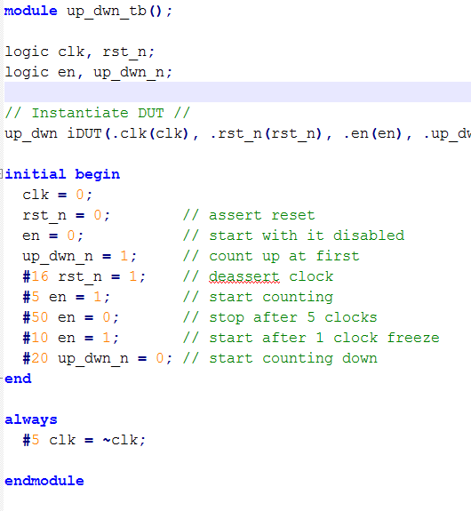
Stimulus for Sequential Circuits
Can do it using delays as shown here.
Signal timings are calculated based on your clock period
Figuring it out is a pain
What if you want to change the clock period?
There is a better way

Slide 22
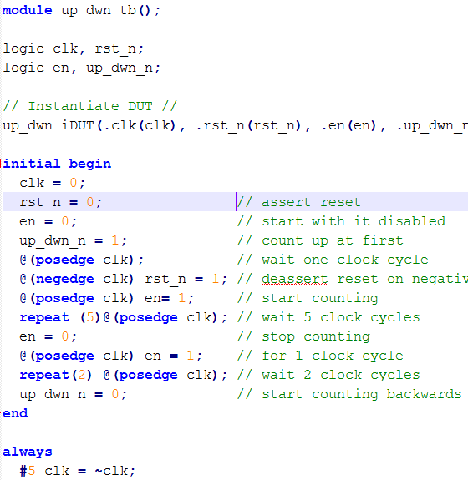
Stimulus for Sequential Circuits
Can use clock edges as trigger for stimulus events
Easier to think about, no arithmetic with clock period
Code is independent of clock period
Can use repeat() loop to wait a given number of clocks

Slide 23
FSM Testing
Response to input vector depends on state
For each state:
Check all transitions
Check output for each transition
This includes any transitions back to same state!
Can be time consuming to traverse FSM repeatedly…

Slide 24
Example : Gray Code Counter – Test1 (the instructor is a chicken)
Write a testbench to test a gray code counter module gray_counter(out, clk, rst);
Rst in this case is a synchrounous reset
It does not directly asynchronously reset the flops
It is an input to the combinational logic that sets the next state to all 0’s.
Initially reset the counter and then test all states, but do not test reset in each state.

Slide 25
Bubble Diagram of 3-bit Gray Code “State Machine”
001
rst
rst
011
rst
000
rst
rst
rst
010
rst
100
rst
rst
rst
rst
110
rst
101
111
rst
rst

Slide 26
Solution : Gray Code Counter – Test1
module t1_gray_counter();
wire [2:0] out;
reg clk, rst;
gray_counter GC(out, clk, rst); // DUT
initial $monitor(“%t out: %b rst: %b ”, $time, out, rst); // no clock
initial #100 $finish; // end simulation, quit program
initial begin
clk = 0;
rst = 1;
#10 rst = 0; // release reset after first clock rise and let run end
always
#5 clk = ~clk; // clock rising edges at 5,15,25,…
endmodule

Slide 27
Simulation: Gray Code Counter – Test1
# 0 out: xxx rst: 1 // reset system
# 5 out: 000 rst: 1 // first positive edge
# 10 out: 000 rst: 0 // release reset
# 15 out: 001 rst: 0 // traverse states
# 25 out: 011 rst: 0
# 35 out: 010 rst: 0
# 45 out: 110 rst: 0
# 55 out: 111 rst: 0
# 65 out: 101 rst: 0
# 75 out: 100 rst: 0
# 85 out: 000 rst: 0
# 95 out: 001 rst: 0

Slide 28
Force/Release In Testbenches
Allows you to “override” value FOR SIMULATION
Doesn’t do anything in “real life”
How does this help testing?
Can help to pinpoint bug
Can use with FSMs to override state
Force to a state
Test all transitions/outputs for that state
Force the next state to be tested, and repeat
Can help achieve code coverage (more on that later)

Slide 29
Force/Release Example
assign y = a & b;
assign z = y | c;
initial begin
a = 0; b = 0; c = 0;
#5 a = 0; b = 1; c = 0;
#5 force y = 1;
#5 b = 0;
#5 release y;
#5 $stop;
end
T a b c y z
0 0 0 0 0 0
5 0 1 0 0 0
10 0 1 0 1 1
15 0 0 0 1 1
20 0 0 0 0 0

Slide 30
Example : Gray Code Counter – Test2
Write a testbench to exhaustively test the gray code counter example above
module gray_counter(out, clk, rst);
Initially reset the counter and then test all states, then test reset in each state.
Remember that in this example, rst is treated as an input to the combinational logic.
Thoroughly

Slide 31
Bubble Diagram of 3-bit Gray Code “State Machine”
001
rst
rst
011
rst
000
rst
rst
rst
010
rst
100
rst
rst
rst
rst
110
rst
101
111
rst

Slide 32
Example : Gray Code Counter – Test2
module t2_gray_counter();
wire [2:0] out;
reg clk, rst;
gray_counter GC(out, clk, rst); // DUT
initial $monitor(“%t out: %b rst: %b ”, $time, out, rst); // no clock
initial #300 $finish; // end simulation, quit program
initial begin
clk = 0; forever #5 clk = ~clk; // What is the clock period? end
initial begin
rst = 1; #10 rst = 0;
#90 rst = 1; force GC.ns = 3'b001; #10 release GC.ns;
#10 force GC.ns = 3'b001; #10 release GC.ns;
#10 force GC.ns = 3'b010; #10 release GC.ns;
…
end // initial
endmodule
Note the Use of hierarchical
Naming to get at the internal
Signals. This is a very handy
thing in testbenches.

Slide 33
Simulation: Gray Code Counter – Test2
# 0 out: xxx rst: 1
# 5 out: 000 rst: 1
# 10 out: 000 rst: 0
# 15 out: 001 rst: 0
# 25 out: 011 rst: 0
# 35 out: 010 rst: 0
# 45 out: 110 rst: 0
# 55 out: 111 rst: 0
# 65 out: 101 rst: 0
# 75 out: 100 rst: 0
# 85 out: 000 rst: 0
# 95 out: 001 rst: 0
# 100 out: 001 rst: 1
# 105 out: 000 rst: 1
// at #115 out = 000
# 125 out: 001 rst: 1
# 135 out: 000 rst: 1
# 145 out: 011 rst: 1
# 155 out: 000 rst: 1
# 165 out: 010 rst: 1
# 175 out: 000 rst: 1
# 185 out: 110 rst: 1
# 195 out: 000 rst: 1
# 205 out: 111 rst: 1
# 215 out: 000 rst: 1
# 225 out: 101 rst: 1
# 235 out: 000 rst: 1
# 245 out: 100 rst: 1
# 255 out: 000 rst: 1

Slide 34
Dataflow Verilog
The continuous assign statement
It is the main construct of Dataflow Verilog
It is deceptively powerful & useful
Generic form:
assign [drive_strength] [delay] list_of_net_assignments;
Where:
list_of_net_assignment ::= net_assignment [{,net_assignment}]
& Where:
Net_assignment ::= net_lvalue = expression
OK…that means just about nothing to me…how about some examples?

Slide 35
Continuous Assign Examples
Simplest form:
// out is a net, a & b are also nets
assign out = a & b; // and gate functionality
Using vectors
wire [15:0] result, src1, src2; // 3 16-bit wide vectors
assign result = src1 ^ src2; // 16-bit wide XOR
Can you implement a 32-bit adder in a single line?
wire [31:0] sum, src1, src2; // 3 32-bit wide vectors
assign {c_out,sum} = src1 + src2 + c_in; // wow!
What is this?

Slide 36
Vector concatenation
Can “build” vectors using smaller vectors and/or scalar values
Use the {} operator
Example 1
becomes 8-bit vector:
a₁a₀b₁b₀c₁c₀da₂
module concatenate(out, a, b, c, d);
input [2:0] a;
input [1:0] b, c;
input d;
output [9:0] out;
assign out = {a[1:0],b,c,d,a[2]};
endmodule

Slide 37
Vector concatenation
Example 2
module add_concatenate(out, a, b, c, d);
input [7:0] a;
input [4:0] b;
input [1:0] c;
input d;
output [7:0] out;
add8bit(.sum(out), .cout(), .a(a), .b({b,c,d}), .cin());
endmodule
Vector concatenation is not limited to assign statements. In this example it is done in a port connection of a module instantiation.

Slide 38
Replication within Concatenation
Sometimes it is useful to replicate a bit (or vector) within the concatenation of another vector.
This is done with a replication constant (number) in front of the {}
Example: (sign extend an 8-bit value to a 16bit bus)
input [7:0] offset; // 8-bit offset term from EEPROM
wire [15:0] src1; // 16-bit source busses to ALU
assign src1 = {{8{offset[7]}},offset}; // sign extend offset term
Recall, to sign extend a 2’s complement number you just replicate the MSB.
In this example the MSB of the 8-bit offset term has to be replicated 8 times to flush out to a full 16-bit value

Slide 39
Back to the Continuous Assign
More basic generic form: assign <LHS> = <RHS expression>;
If RHS result changes, LHS is updated with new value
Constantly operating (“continuous”)
It’s hardware!
RHS can use operators (i.e. +,-,&,|,^,~,>>,…)
src1[31:0]
src2[31:0]
c_in
➔
assign {c_out,sum} = src1 + src2 + c_in;
c_out
sum[31:0]

Slide 40
Operators: Arithmetic
Much easier than structural! * multiply ** exponent / divide % modulus + add - subtract
Some of these don’t synthesize
Also have unary operators +/- (pos/neg)
Understand bitsize!
Can affect sign of result
Is affected by bitwidth of BOTH sides Prod[7:0] = a[3:0] * b[3:0]

Slide 41
Operators
Shift (<<, >>, <<<, >>>)
Relational (<, >, <=, >=)
Equality (==, !=, ===, !==)
===, !== test x’s, z’s! ONLY USE FOR testbenches
Logical Operators (&&, ||, !)
Build clause for if statement or conditional expression
Returns single bit values
Bitwise Operators (&, |, ^, ~)
Applies bit-by-bit!
Watch ~ vs !, | vs. ||, and & vs. &&

Slide 42
Reduction Operators
Reduction operators reduce all the bits of a vector to a single bit by performing an operation across all bits.
Reduction AND
assign all_ones = &accumulator; // are all bits set?
Reduction OR
assign not_zero = |accuumulator; // are any bits set?
Reduction XOR
assign parity = ^data_out; // even parity bit

Slide 43
Lets Kick up the Horse Power
You thought a 32-bit adder in one line was powerful. Lets try a 32-bit MAC…
Design a multiply-accumulate (MAC) unit that computes
Z[31:0] = A[15:0]*B[15:0] + C[31:0]
It sets overflow to one, if the result cannot be represented using 32 bits.
module mac(output Z [31:0], output overflow,
input [15:0] A, B, input [31:0] C);

Slide 44

Lets Kick up the Horse Power
module mac(output Z [31:0], output overflow,
input [15:0] A, B, input [31:0] C);
assign {overflow, Z} = A*B + C;
endmodule
I am a brilliant genius. I am a HDL coder extraordinaire. I created a 32-bit MAC, and I did it in a single line.
assign {overflow, Z} = A*B + C;
Oh my god, I’ve created a monster
Synopsys

Slide 45
Conditional Operator
This is a favorite!
The functionality of a 2:1 Mux
assign out = conditional_expr ? true_expr : false_expr;
Examples:
// a 2:1 mux
assign out = select ? in1 : in0;
// tri-state bus
assign src1 = rf2src1 ? Mem[addr1] : 16’hzzzz;
// Either true_expr or false_expr can also be a conditional operator
// lets use this to build a 4:1 mux
assign out = sel[1] ? (sel[0] ? in3 : in2) : (sel[0] ? in1 : in0);
false_expr
0
out
true_expr
1
cond_expr

Slide 46
Conditional assign (continued)
Examples: (nesting of conditionals)
localparam add = 3'b000
localparam and = 3'b001
localparam xor = 3'b010
localparam shft_l = 3'b011
localparam shft_r = 3'b100
// an ALU capable of arithmetic,logical, shift, and zero
assign {cout,dst} = (op==add) ? src1+src2+cin :
(op==and) ? {1’b0,src1 & src2} :
(op==xor) ? {1’b0,src1 ^ src2} :
(op==shft_l) ? {src1,cin} :
(op==shft_r) ? {src1[0],src1[15],src1[15:1]} :
17’h00000;
This can be very confusing to read if not coded with proper formating

Slide 47
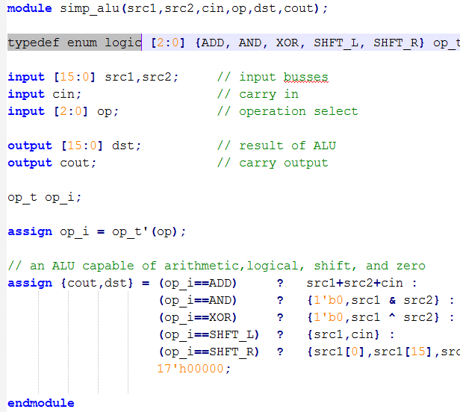

System Verilog for ALU
Again, system verilog allows for the use of enumerated types.
Does not make the code more readable, but does enhance debug because of waveform view.

Slide 48
A Few Other Possibilities
The implicit assign
Goes in the wire declaration wire [3:0] sum = a + b;
Can be a useful shortcut to make code succinct, but doesn’t allow fancy LHS combos assign {cout, sum} = a + b + cin;
Personal choice
You are welcome to use it when appropriate (I never do)

Slide 49
Implicit Net Declarations
When wire is used but not declared, it is implied
module majority(output out, input a, b, c);
assign part1 = a & b; assign part2 = a & c; assign part3 = b & c; assign out = part1 | part2 | part3; endmodule
Defaults to single bit wire
Breaks compatibility with some tools
Disable by using `default_nettype none directive
Helps to avoid wasting time on typos

Slide 50
Latches with Continuous Assign
What does the following statement imply/do?
assign q_out = enable ? data_in : q_out;
It acts as a latch. If enable is high new data goes to q_out. Otherwise q_out maintains its previous value.
Ask yourself…It that what I meant when I coded this?
It simulates fine…just like a latch

Slide 51
Latches with Continuous Assign
assign q_out = enable ? data_in : q_out;
How does it synthesize??
0
data_in
q_out
q_out
en
data_in
1
enable
enable
Is the synthesizer smart enough to see this as a latch
and pick a latch element from the standard cell library?
Or is it what you code is what you get? A combinational feedback loop. Still acts like a latch. Do you feel comfortable with this?

